Slide 1
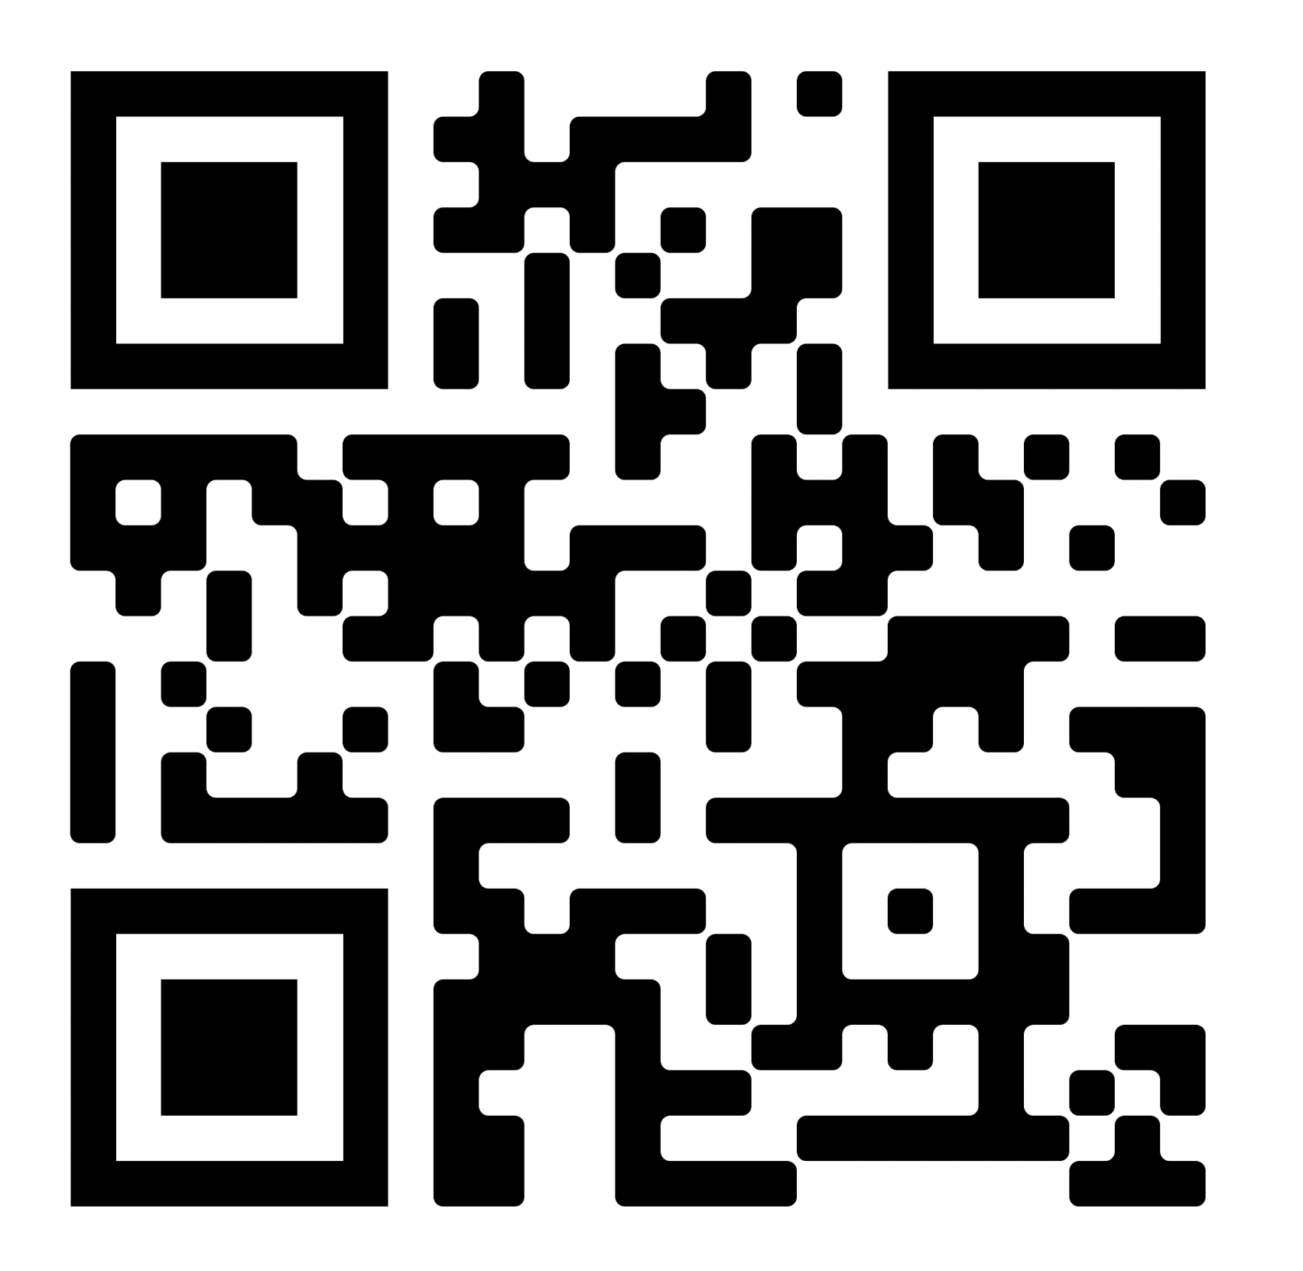
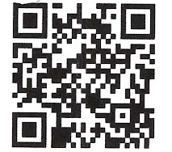


Early Voting Dates
Voter Registration Deadlines
Mail-in forms: Mailed forms must postmarked October 16th.
In-Person Forms: delivered to Registrars of Voters by 8 p.m. on October 16.
Online Registration: Friday, October 16th by 11:59
Same-Day registration: You can register in-person during all early voting hours and on election day, but only at your town’s designated same-day registration sites
Early Voting Dates & Hours
Monday, October 19th through Sunday, November 1st
Hours: 10 a.m. – 6 p.m. Daily
Extended hours:
Tuesday, October 27th: 8 a.m. – 8 p.m.
Thursday, October 29th: 8 a.m. – 8 p.m.
For your Election Day Polling Location scan this QR Code and enter your address OR call your town’s Registrar of Voters
Early Voter polling locations
Election Day, Hours, Locations
Tuesday, November 3rd
Hours: 6 a.m. – 8 p.m.
For your Election Day Polling Location scan this QR Code and enter your address or call your town’s Registrar of Voters
CT Voter Registration & Polling Place Lookup
Trusted Resources:
CT Secretary of State, https://portal.ct.gov/sots
CT State Elections Enforcement Commission, https://portal.ct.gov/seec
Your Town’s Registrars of Voters
Courtesy of Greater Westville Indivisible, greaterwestvilleindivisible@gmail.com

